Slide 1
NATURAL LANGUAGE PROCESSING
PEERMENTORS-
190330012
190330093

Slide 2
TABLE OF CONTENTS-
INTRODUCTION
PROBLEM STATEMENT
DATASETS USED
IMPORT LIBRARIES
MODEL CREATION
TRAINING
OUTPUT

Slide 3
INTRODUCTION
Handwritten digit recognition is the process to provide the ability to machines to recognize human handwritten digits. It is not an easy task for the machine because handwritten digits are not perfect, vary from person-to-person, and can be made with many different flavors.

Slide 4
PROBLEM STATEMENT
we are going to use the MNIST dataset for the implementation of a handwritten digit recognition app. To implement this we will use a special type of deep neural network called Convolutional Neural Networks. In the end, we will also build a Graphical user interface(GUI) where you can directly draw the digit and recognize it straight away.

Slide 5
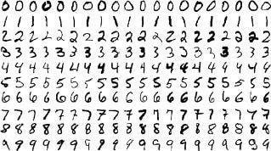
DATA SETS USED(MNIST)
MNIST dataset consists of handwritten digits from 0 to 9 and has a training set of 60,000 samples, and a test set of 10,000 samples. The digits are binary 28x28 pixels.

Slide 6
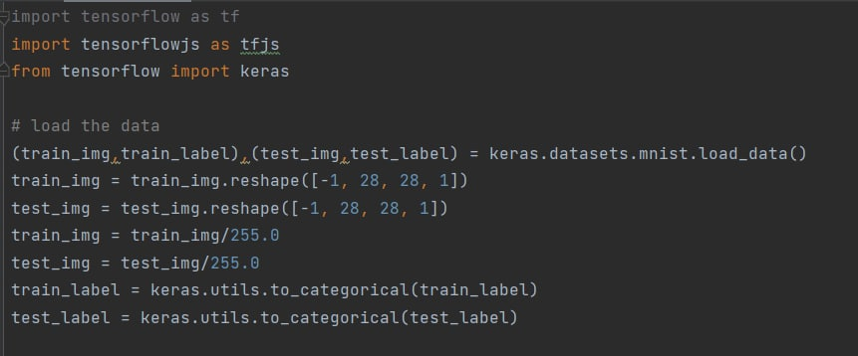
IMPORT LIBRARIES AND DATASET
we import all the needed modules for training our model. We can easily import the dataset and start working on that because the Keras library already contains many datasets and MNIST is one of them. We call mnist.load_data() function to get training data with its labels and also the testing data with its labels.
Model cannot take the image data directly so we need to perform some basic operations and process the data to make it ready for our neural network. The dimension of the training data is (60000*28*28). One more dimension is needed for the CNN model so we reshape the matrix to shape (60000*28*28*1).

Slide 7
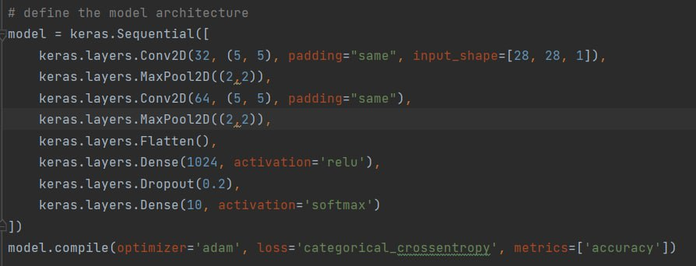
MODLE CREATION
We use CNN (convolution neural network) for this project
We will use the Adadelta optimizer for the model compilation.
We use model architecture as keras sequential
Cross entropy is used as loss function

Slide 8
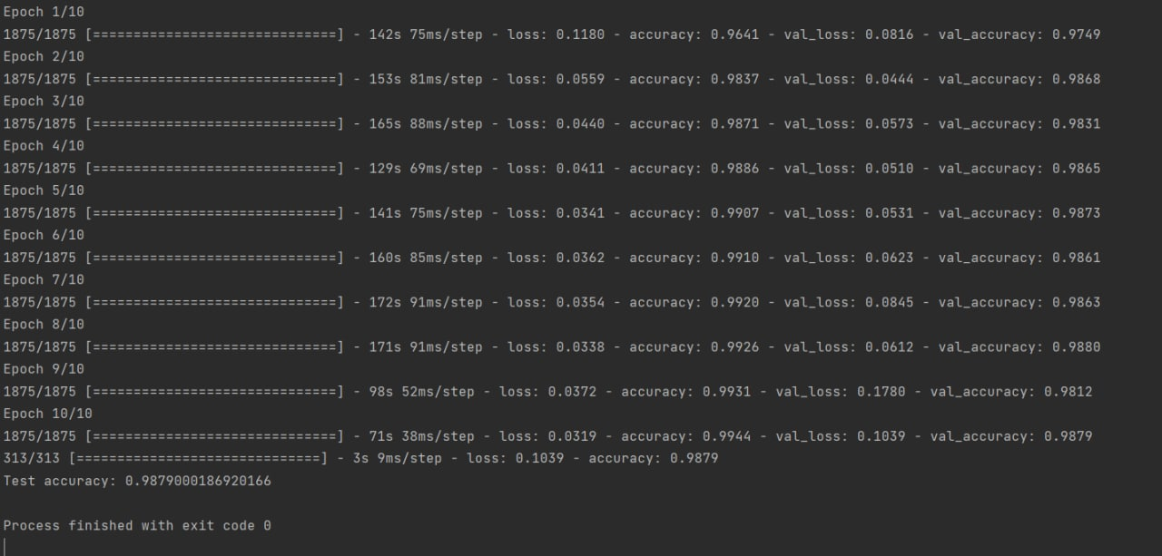
TRAINING
To start the training of the model we can simply call the model.fit() function of Keras. It takes the training data, validation data, epochs, and batch size as the parameter.
The training of model takes some time. After succesful model training, we can save the weights and model definition in the ‘mnist.h5’ file.

Slide 9
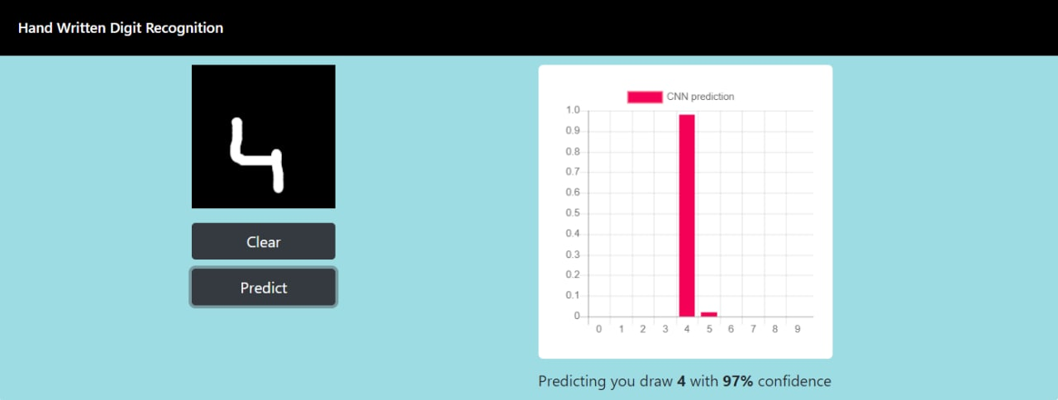
OUTPUT

Slide 10
THANK YOU

